Slide 1


XN Project ALY6080 INTEGRATED EXPERIENTIAL LEARNING Professor: Kristen Drobnis
Team 2: Anar Gochiyev,
Anil Singh Chouhan,
Ashish Kumar,
Catherine Richard,
Pranay Chidura, Wanlu Yao
Notes:
Title Page

Slide 2

Agenda
Introduction
Company Overview
Business Problem & Solution
Data Collection Methods
Exploratory Data Analysis
Conclusion
Recommendations
References
Q & A

Slide 3
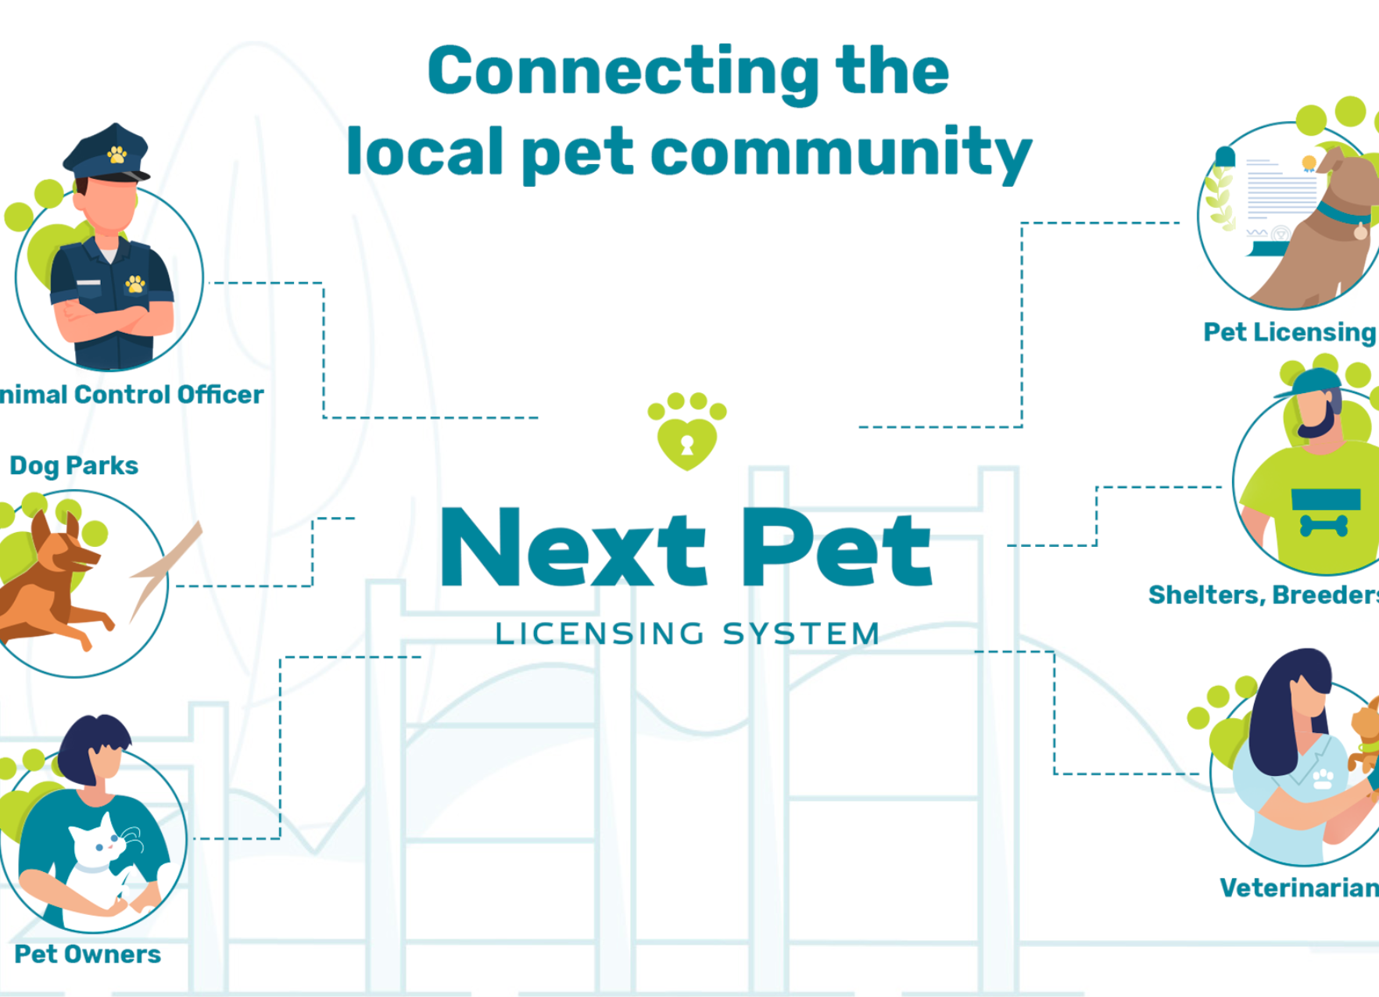
Company Overview
Pet & Tie, LLC
Startup Company founded in 2015
Pet Service industry
Main Products : GoPetie Moblie APP
NEXT Pet Licensing System
Connect pet owners with each other and municipalities as well as pet service providers.

Slide 4

Business Problem & Solution
Problem Overview
Getting in touch with public officials is an important part of business
Extremely time-consuming process for information collection due to no consolidated contact list and public officials change often due to elections.
Solution
Multiple Data Collection Methods
Automatic Process and Easy Implementation Steps
Interactive Dashboard

Slide 5
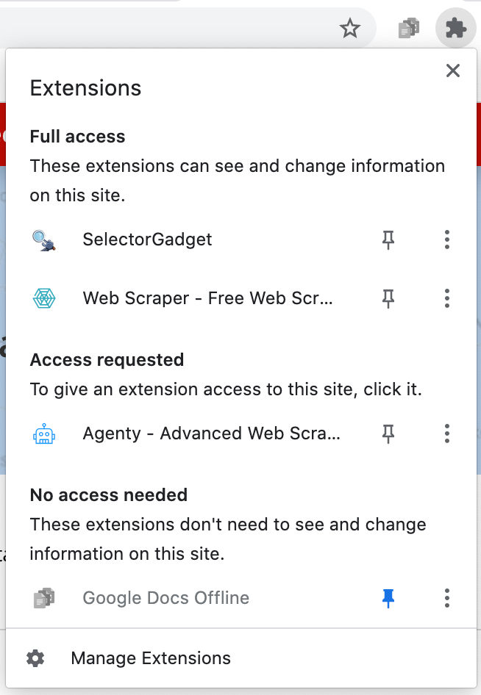
Data Collection Method I
Install
Install extension & Create account
Go
Go to the target website &
Create scraping agent
Name
Name your agent &
Enable selector to select the valid path for the target information

Slide 6
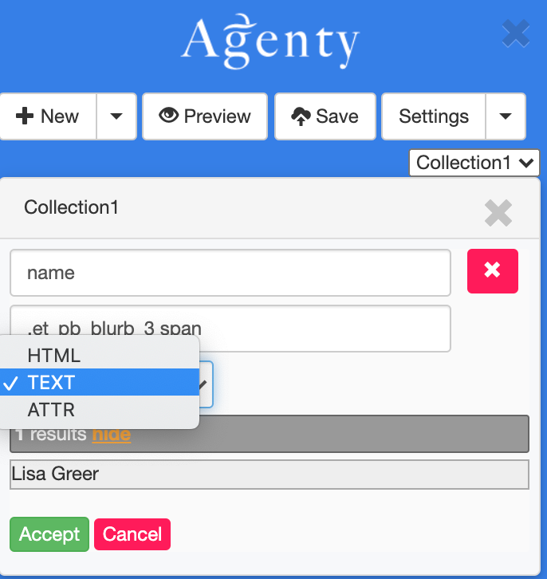
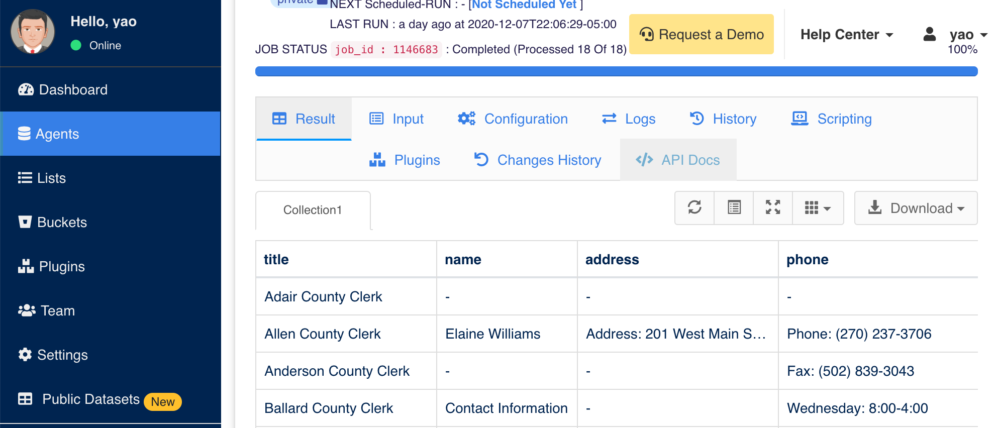
Data Collection Method I
Select
Select your information type & Accept selectors
Save
Save agent and goes to the directed URL
Download
Download the scraped information as CSV/TSV/JSON file

Slide 7
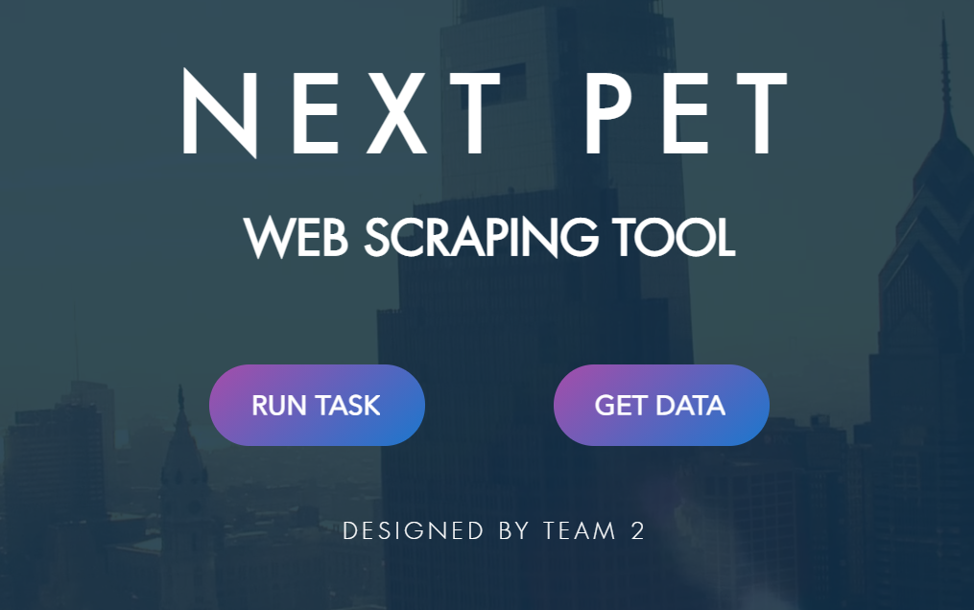
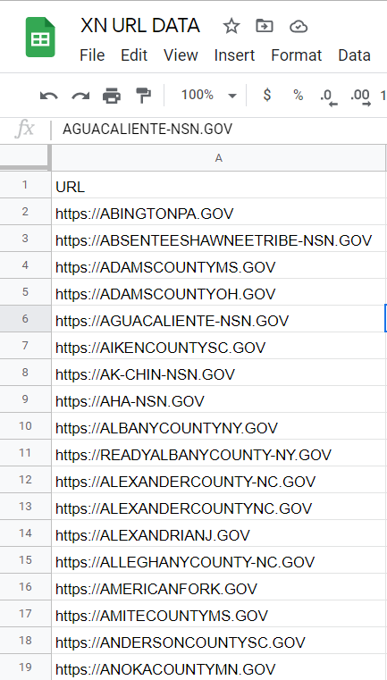

Data Collection Method II
Enter Website URL's in the Google Sheet
Click RUN on the Web Page
Retrieve Data
The APIFY API will be invoked and run the tool

Slide 8
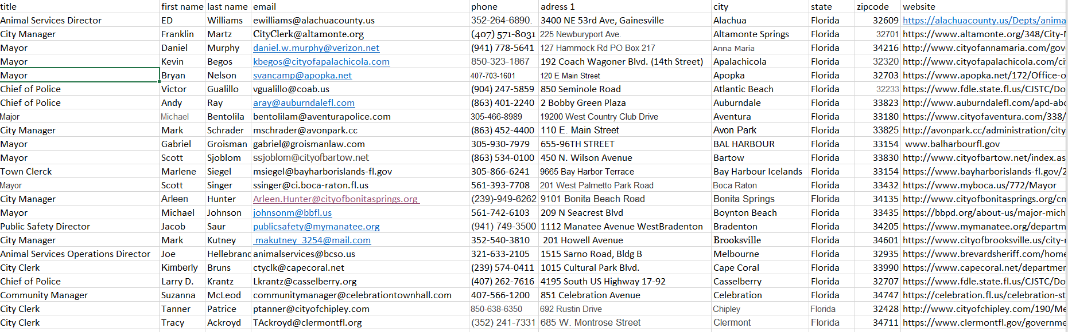
Data Collection Method III
Although in general we collected most of the data by using web scraper tools, we did some manual work too.
Reason: To see whether there is any position in municipalities who specifically deal with pet licensing
Finding: Based on analysis of more than 100 official websites of municipalities and cities, we come to conclusion that there is no contact details of specific position in every country who deal with pet licensing or animal control.

Slide 9
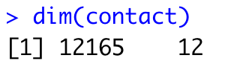
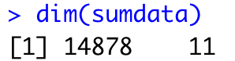

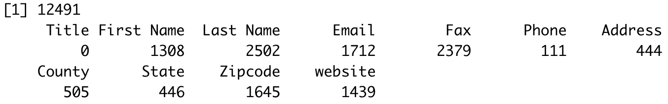
Data Analysis
Dimension Comparison
2713 more data points
1 column less (removed the address 2 & country column add a column named fax)
Missing Value Comparison
Comparing to sponsor’s data,
our data has fewer missing values.
The columns that contains the
most NAs are “Last Name” and “Fax”

Slide 10
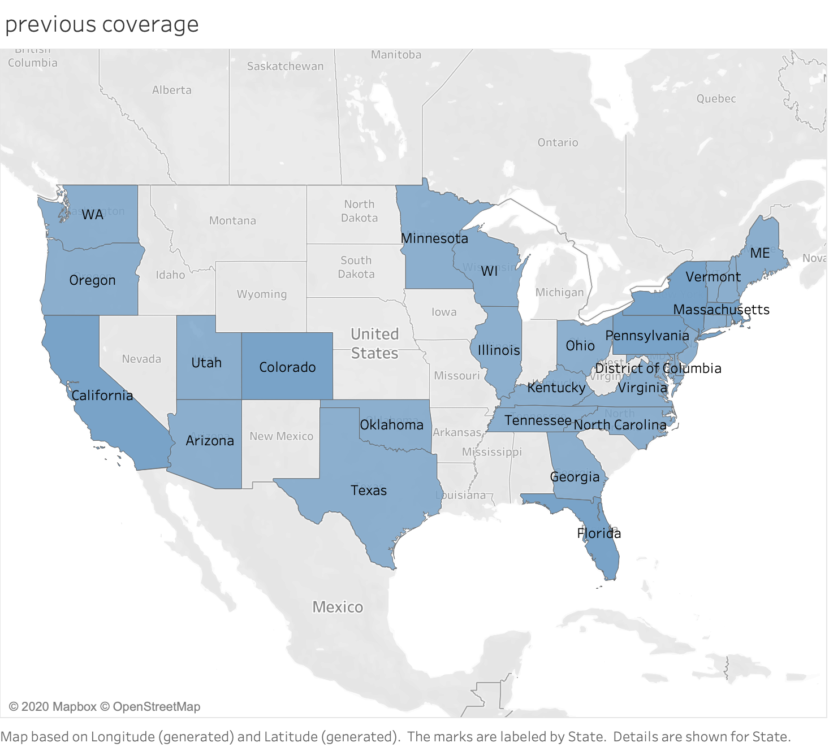
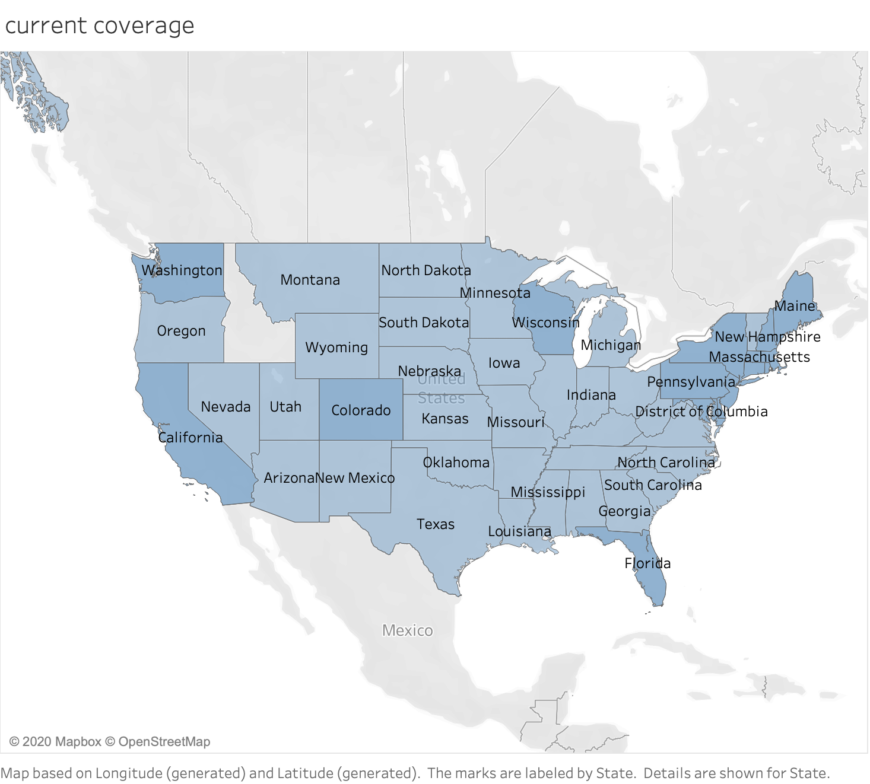
Exploratory Data Analysis
In comparison of the two maps, we can see that our collected contact information have covered almost every state among the United States, including the states that Next Pet are targeting.

Slide 11

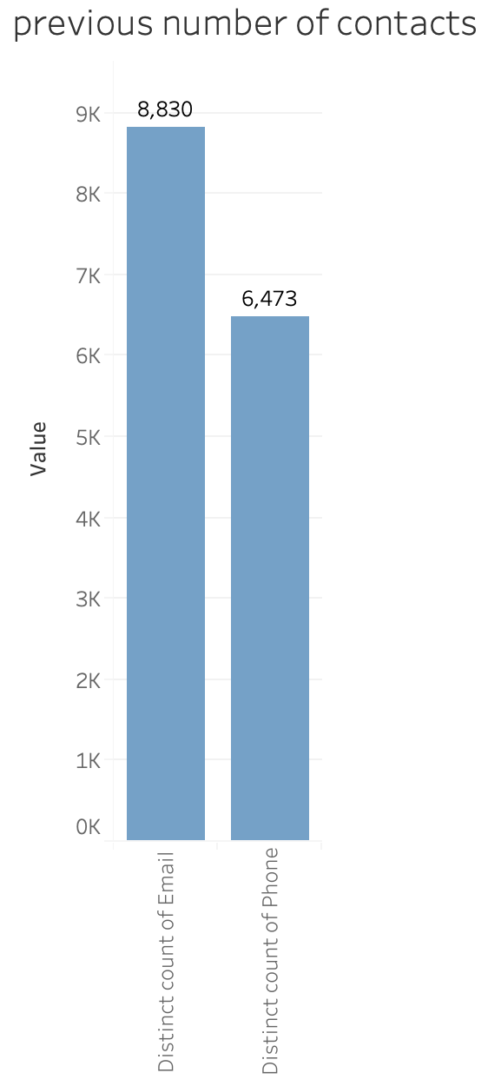
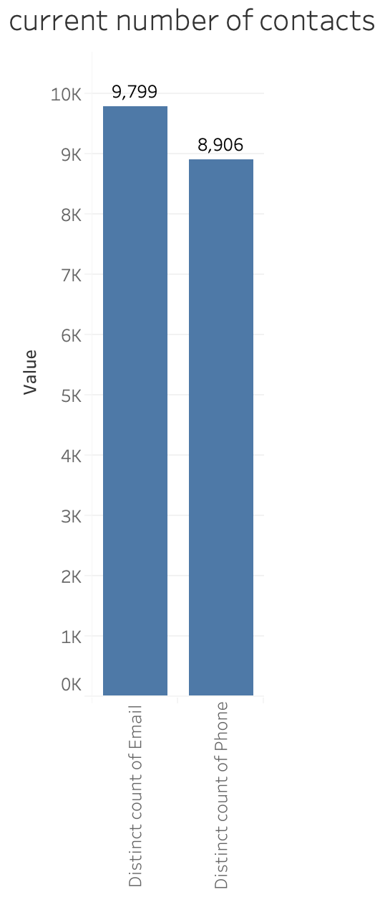
Exploratory Data Analysis
We also created visuals to show the number
of changes between emails and phones.
For emails:
Increases by 11%, with 969 points added
For phone numbers:
Increase by 37.6%, with 2433 points added

Slide 12
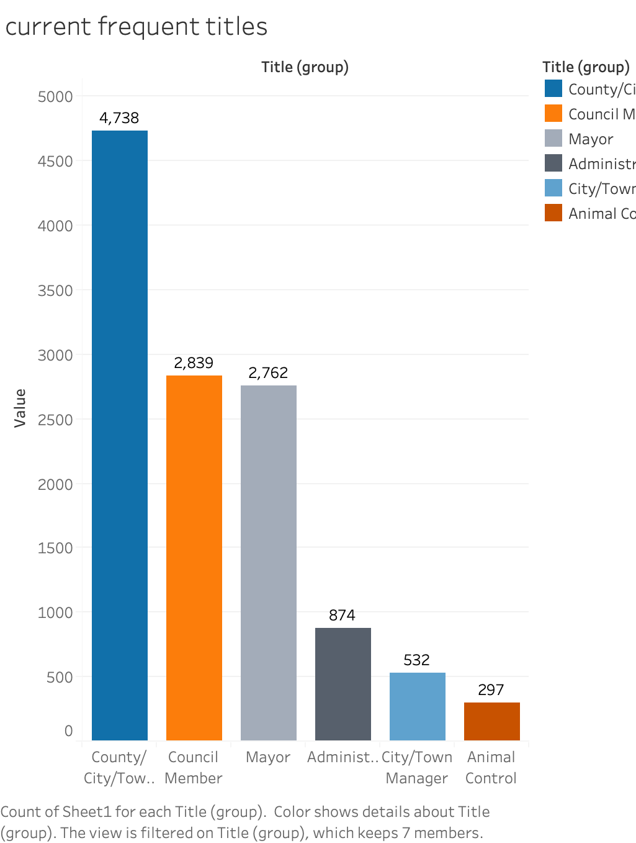
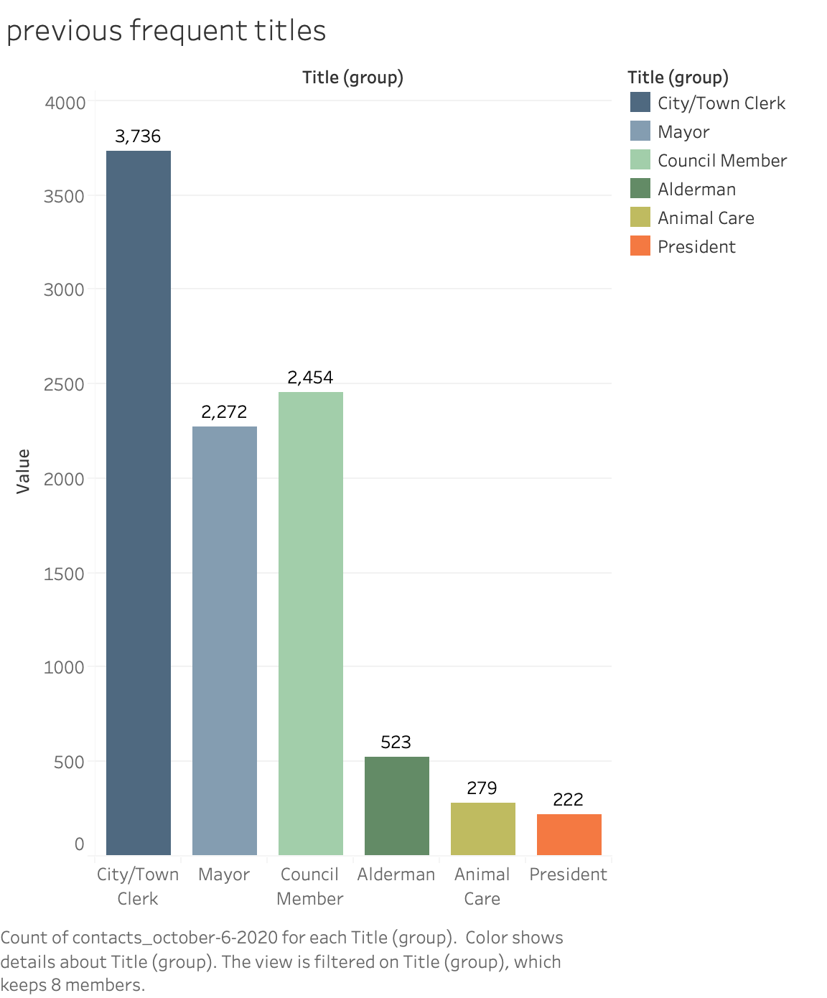
Exploratory Data Analysis
When we do a comparison between both charts, we can notice that the contact details have been increased significantly and
Now, we have more contacts of council members than mayor as compared to the dataset of Next Pet where contact details of Mayor were higher.

Slide 13
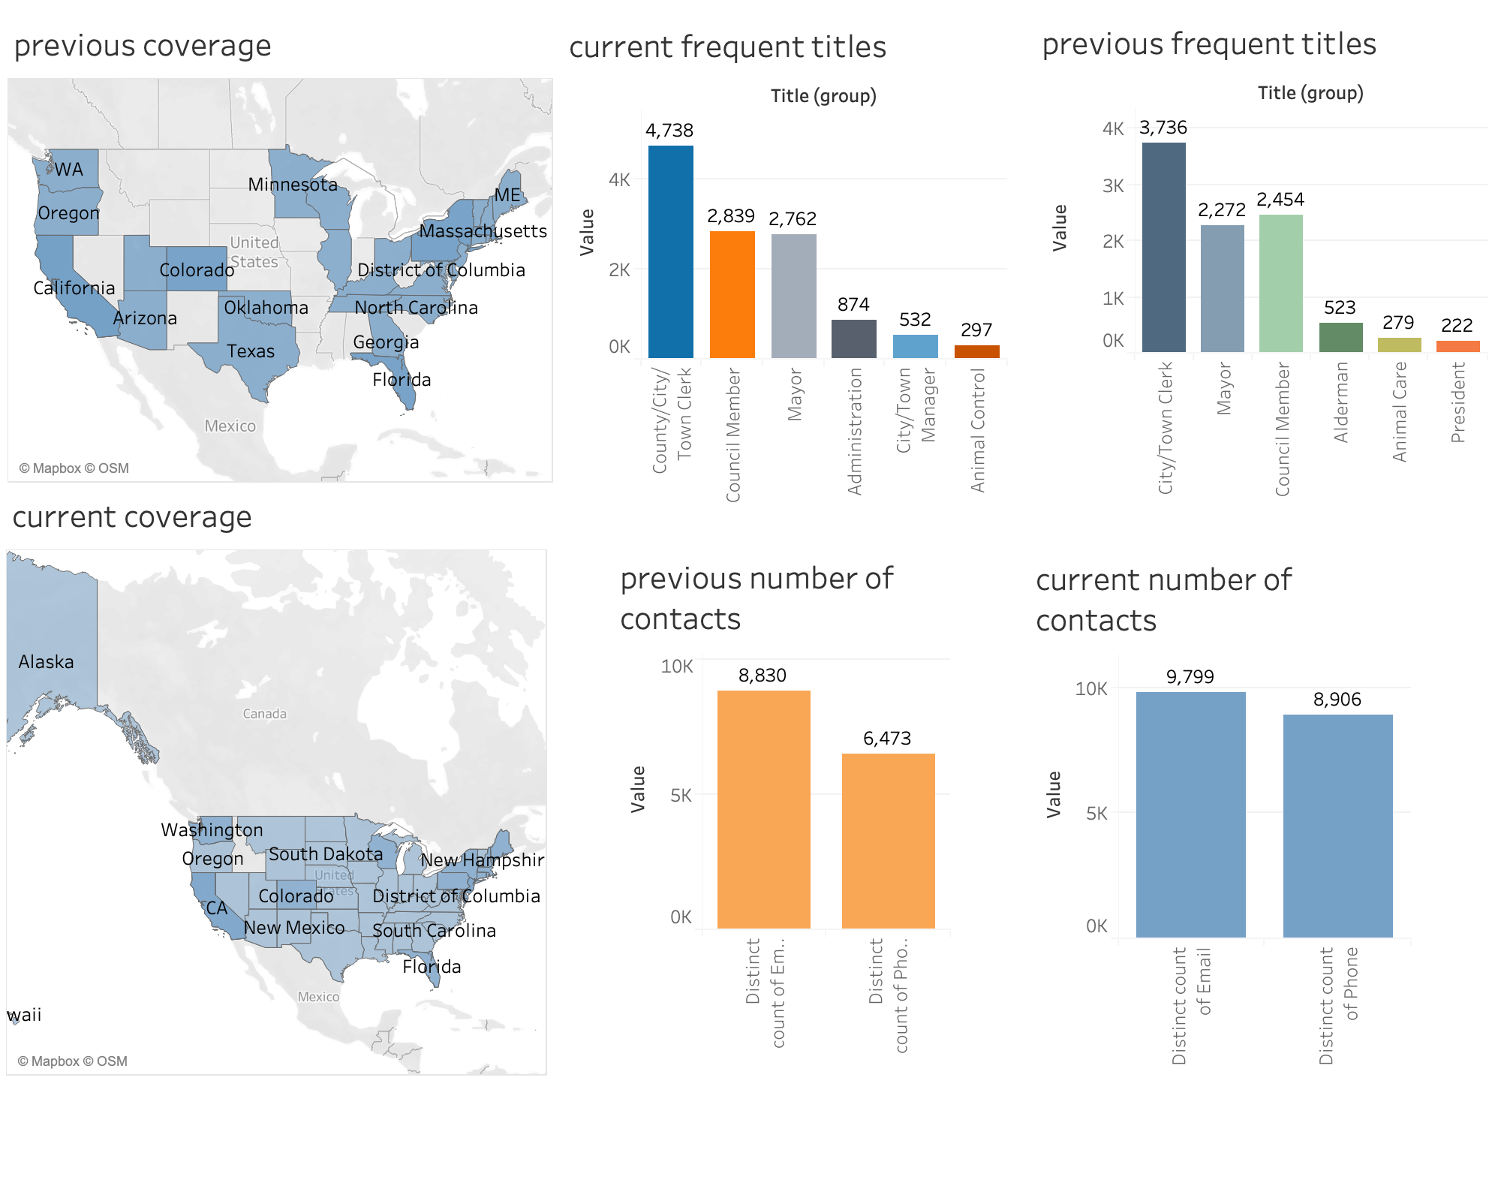
Dashboard
Interactive Dashboard
Tool: Tableau

Slide 14


Conclusion
Throughout the project, we updated the existing data and add new data points by using web scraping technique and manual way of collecting data.
We provided Next Pet contact information of responsible people regarding pet licensing in different cities almost all over the USA.
We used Tableau essential to provide interactive dashboard visualization of our data and its analysis.
Notes:
Conclusion

Slide 15

Recommendations
Due to competitive environment in the pet licensing as some companies have already expand their area of work, we strongly recommend Next Pet start contracting municipalities as soon as possible.
To get comparative advantage, we recommend Next Pet to offer some no cost services to municipalities such as cloud-based licensing software, implementation planning, program consultations, and community engagement efforts.
Due to different laws, requirements and cost of licensing, we recommend Next Pet to create a Licensing Board, which will consist of departments, which will work on executive, legislative as well as statistical issues.
Beside the data provided by us, we recommend Next Pet to use official website of US Conference of Mayors, where updated contact information of more than 1400 mayors from different cities, which have more than 30000 population, are indicated.

Slide 16

References:
Mester, T.(2020, February 5). Scraping Multiple Web Pages with For Loops (in bash) — Web Scraping Tutorial ep#2. https://data36.com/scraping-multiple-web-pages-urls-with-for-loops/

Slide 17
Q & A? Thank you for watching !

